Slide 1
Embedded FontApocalypse: MS11-087
Никита Тараканов

Slide 2
First of All
Я не связан ни с одной АВ компанией
У меня не было, нету оригинального семлпа, который используется Duqu
Методы тестирования АВ продуктов могут быть некорректными

Slide 3
Небольшой ЛикБез
TTF – TrueType – win32k.sys
OTF – OpenType – atmfd.dll

Slide 4
Хронология уязвимостей
MS10-037 – CFF memory Corruption
MS10-078 – OTF Parsing (2 vulns)
MS10-091 – OTF Parsing (3 vulns)
MS11-003 – OTF Encoded Char vuln
MS11-032 – OTF Parsing

Slide 5
Хронология уязвимостей
MS09-065 – EOT Parsing
MS10-032 – TTF Parsing
MS11-041 – OTF(?) Validation
MS11-077 – TTF,FON vulns
MS11-084 – DoS in TTF Interpreter
MS11-087 – TTF sbit integer vulns

Slide 6
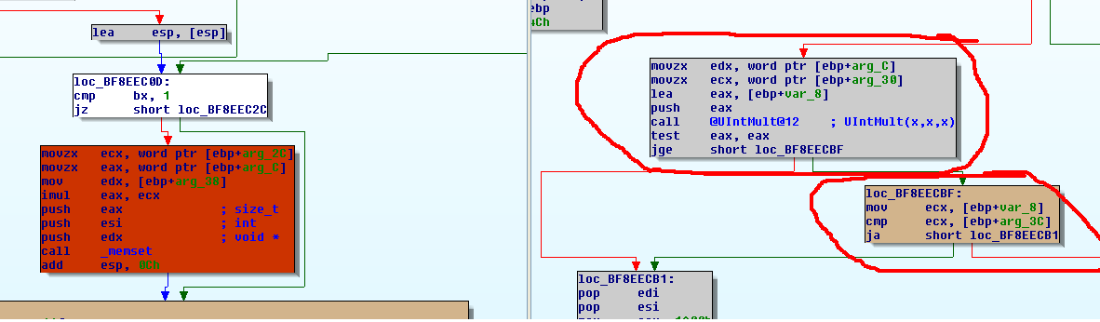
MS11-087(Duqu vuln)

Slide 7
TrueType Bitmap glyphs
EBLC – info about indexes(position) of bitmap data
EBDT – actual bitmap data
EBSC – info about scaling

Slide 8
TrueType Assembler!
Over 100 instructions
Implemented in kernel(!!!) land
Vulns were discovered(MS11-084)
Itrp_XXX – example: itrp_PUSHB
Instructions in cvt table and fpgm

Slide 9
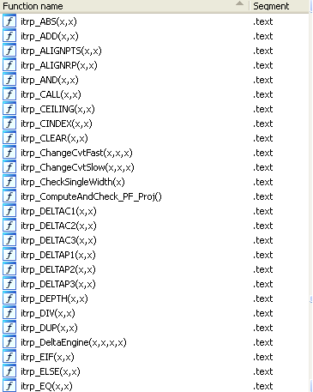
TrueType Assembler

Slide 10
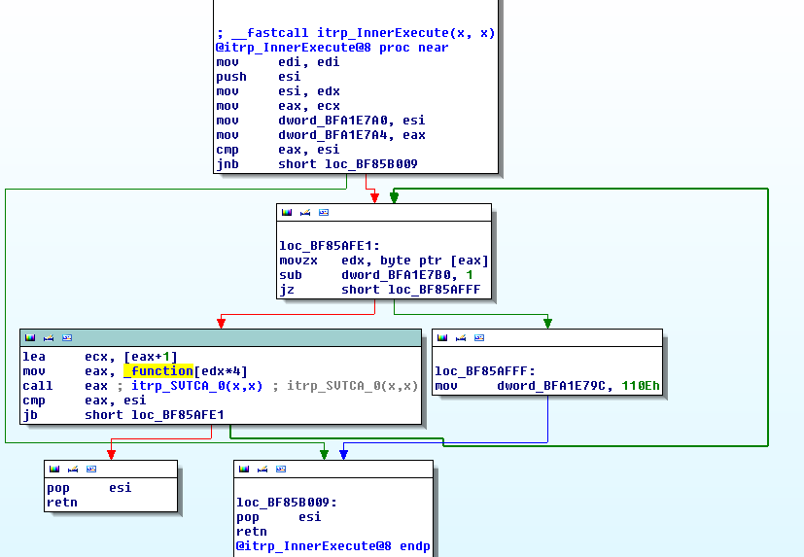
TrueType Assembler

Slide 11
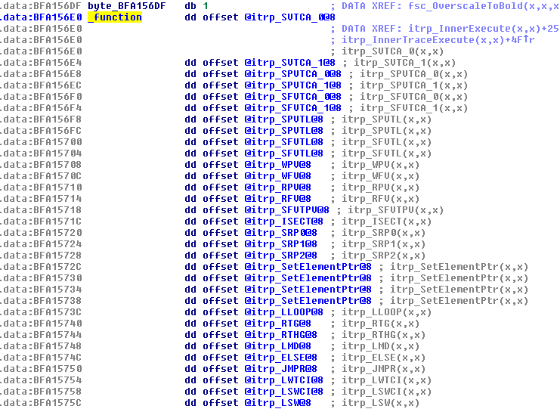
TrueType Assembler

Slide 12
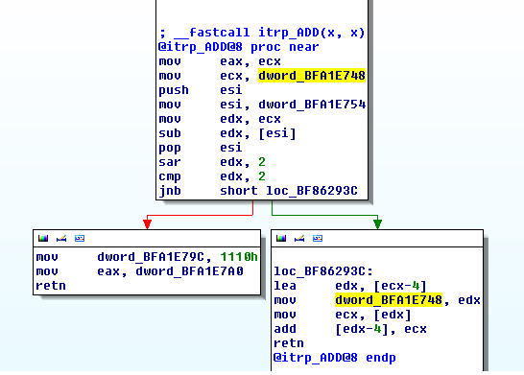
TrueType Assembler

Slide 13
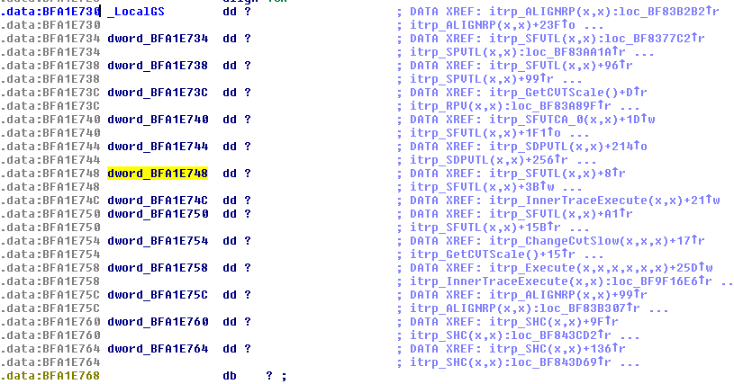
TrueType Assembler

Slide 14
GetSbitComponent
One parameter is TTF interpreter context
Integer overflow leads to kernel pool corruption
Corrupts TTF interpreter context!
This leads to full pwn at r0(!!!) remotely

Slide 15
Lame lame cybercriminals
The guys behind Duqu has failed to exploit this vuln on x64 systems!
Actually, it’s real hardcore: you have to implement ROP program in TTF assembler
TODO: go pwn x64, crack your brain!

Slide 16
MS11-087 attack vectors
TTF – good for Vista/2k8/7/8
DOC – Duqu attack vector
DOCX – same as DOC, but OOXML
IE – drive by download scenario
LPE – no comments…

Slide 17
AV/HIPS vs MS11-087
TTF vector detection: Avast,avira,bitdefender,bullguard,escan,gdata,k7,kl,lavasoft,rising,trustport,vipre,zonealarm
LPE: FAIL, FAIL, FAIL!
Even with MPAA info some AV FAILED to detect mine PoC

Slide 18
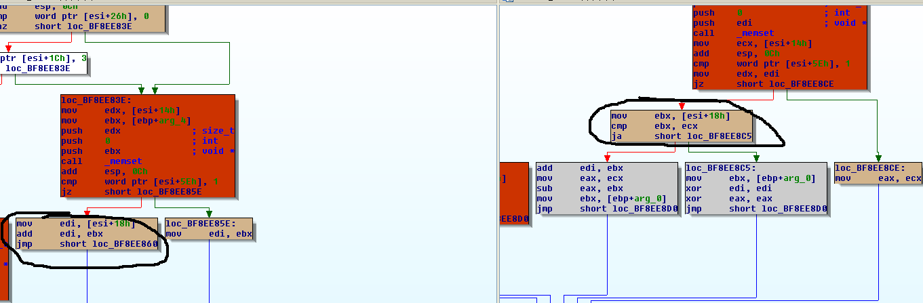
MS11-087 Easter Egg

Slide 19
Kernel Attack Surface
Interrrupts
Syscalls

Slide 20
Interrupts
Exceptions
Interrupt transitions
NTVDM

Slide 21
Syscalls
Ntoskrnl.exe
Win32k.sys

Slide 22
Questions
@NTarakanov
Nikita.tarakanov.researcher@gmail.com

